Slide 1
FLOURISH
Program Details

Slide 2
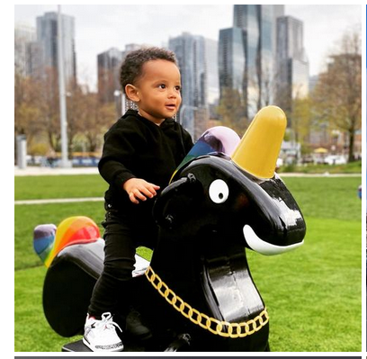
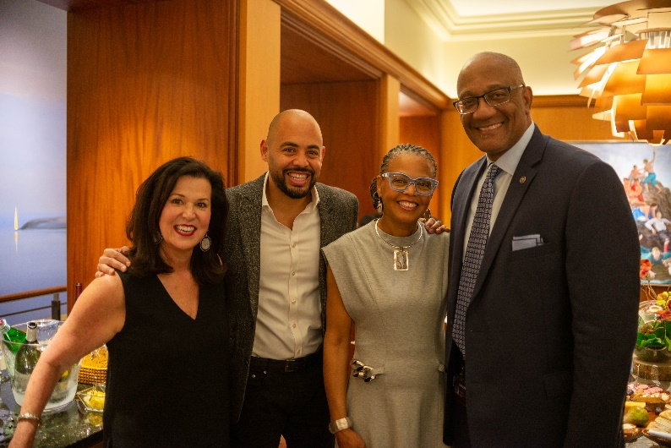
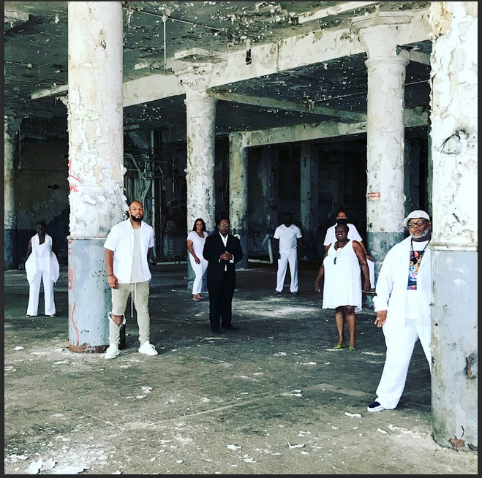
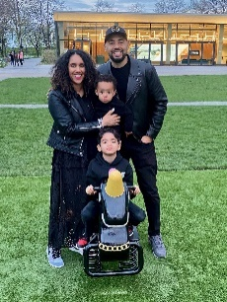
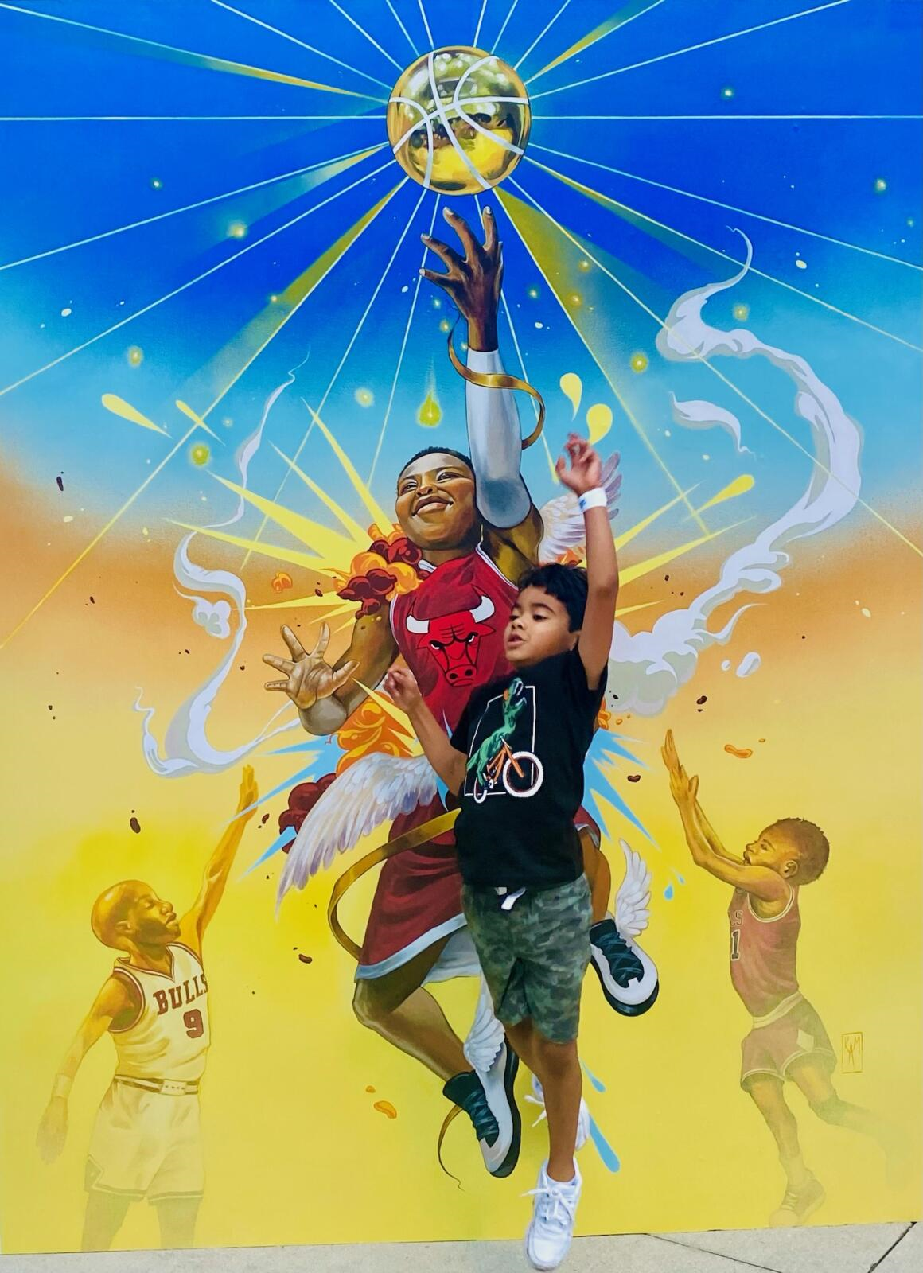
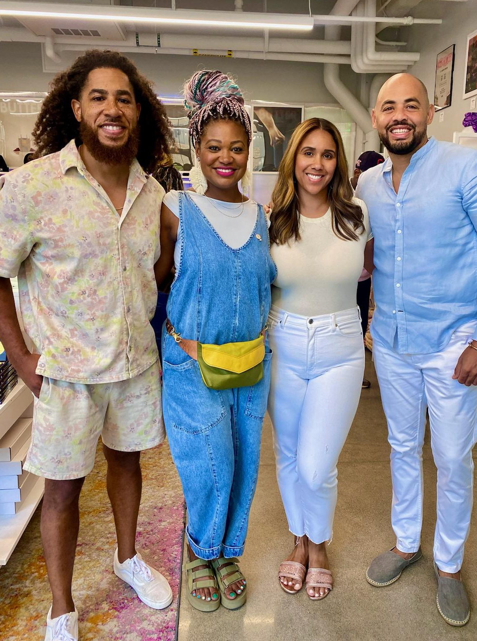
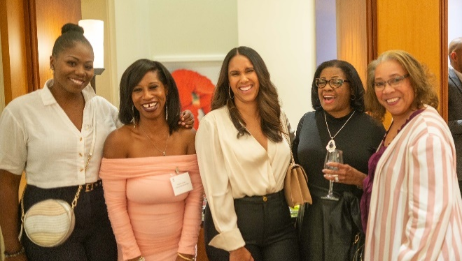
Our Story
Celebrating Diversity in the Fine Arts
FLOURISH
Origin Story
FLOURISH is committed to fostering diversity and inclusivity in the art world by providing resources to underserved Black, Indigenous, and People of Color (BIPOC) creatives to ensure visual arts showcased in fine art museums, galleries and art fairs reflect the diversity of the cities in which they reside.
Our mission is to accelerate the growth of diverse artists and curators through direct investment to support their storytelling through visual arts. Working alongside fine art museums, the business community, and art fairs to provide opportunities, resources, and services to launch diverse creatives to the next level.
Our founders, Tammi and Oscar Bedolla, started the organization as a pledge to their support to help shape a more inclusive world through strategic investment in diverse creatives.

Slide 3
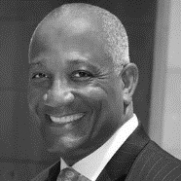
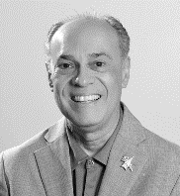
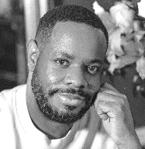
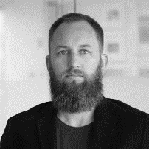
Flourish will provide direct support to diverse artists and curators. These funds will be disbursed through the Flourish Fine Arts Grant Program.
Celebrating Diversity in the Fine Arts
Grant Program Overview
Advocates for Diversity in Fine Arts
Growth through direct investment
- Grant Selection Committee Advisors -
The FLOURISH Grant program was designed to assist in furthering the careers of visual artists and curators living and working in the greater Chicago region. Funding will be provided to support the creation of visual art and exhibits that help to build awareness into identify and culture of Black and Brown people.
More than just a monetary award, FLOURISH will elevate great artists in the Chicago region by providing an opportunity to collaborate with the world-class curatorial staff, business leaders, and art professionals.
Eligibility
Applicants must be at least 21 years old and be a legal resident of the Chicago region since September 1, 2023 (one year prior to applying for funding). Grant funds are eligible to pay for supplies, art studio rental fees, and expenses incurred to produce an art exhibit or visual art that artists may not otherwise be able to afford.
Marquis Miller
Billy Ocasio
Museum of Contemporary Art Trustee
President of the National Puerto Rican Museum
Danny Dunson
Ben FitzGerald
Director of Curatorial Services at DuSable
Partner Lupa Holding Companies
Thomas E. Moore III
Monique Brinkman-Hill
Director of American Friends of the Louvre
Executive Director of South Side Community
Art Center
Event and Grant Program Advisors:
Our team is working closely with leaders within the Chicago Arts Community and nationally that share a deep love for the fine art created by people of color. These advisors are supporting our strategic vision for the FLOURISH grant program.

Slide 4
THE ACCELERATOR PROGRAM
Program Description
The Flourish program accelerates the work of BIPOC (Black, Indigenous, and People of Color) visual artists and curators. The program gives both emerging and established creatives an unparalleled opportunity to develop their practice with financial support, access to industry experts and intuitions.
Funding will be provided for dedicated projects that celebrate ancestry, preserve cultural identity, and address social issues impacting people of color.
Grant funds are eligible to pay for supplies, art studio rental fees, and expenses incurred to produce an art exhibit or visual art that artists may not otherwise be able to afford.
Application Period
July 1st – September 30, 2024
Submission Requirements
Applicants are required to submit a resume or CV, up to ten but no fewer than five images or videos with examples of artworks, and an artist statement; letters of recommendation are encourages but not required.
Eligibility
Applicants must be at least 21 years old and be a legal resident of the Chicago region since July 1, 2023 (one year prior to applying for funding).
Selection Criteria
Priority will be given to BIPOC artists and curators whose practice amplifies the voices of marginalized groups

